Slide 1
Web Development

Slide 2
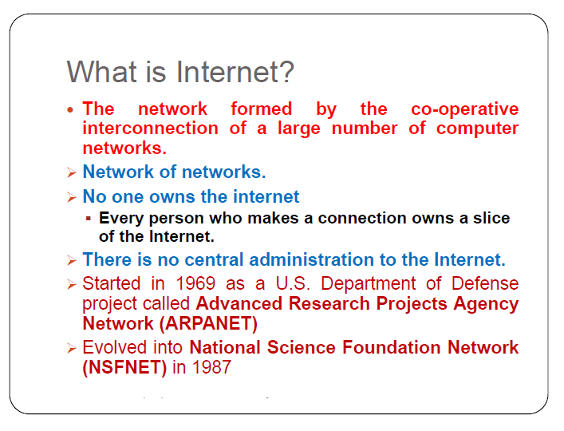
INTERNET

Slide 3
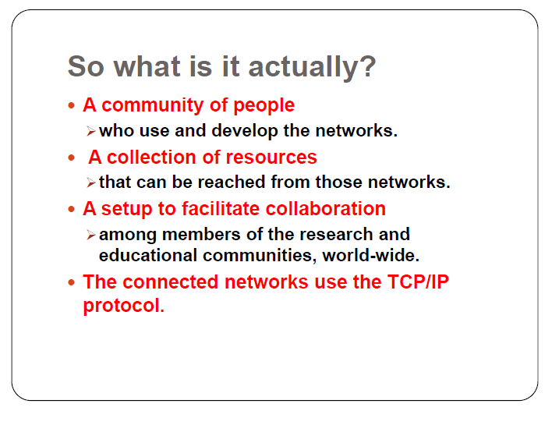
NETWORK COMMUNICATION

Slide 4
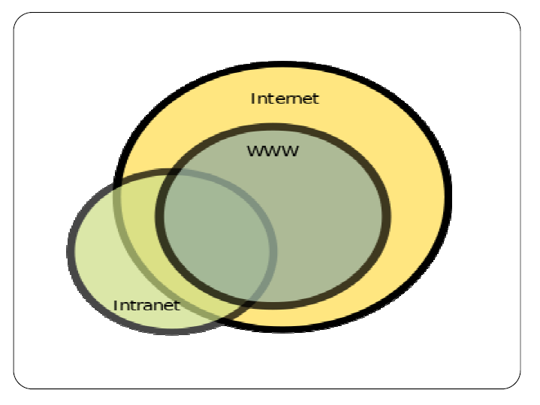
TYPES OF NETWORK

Slide 5
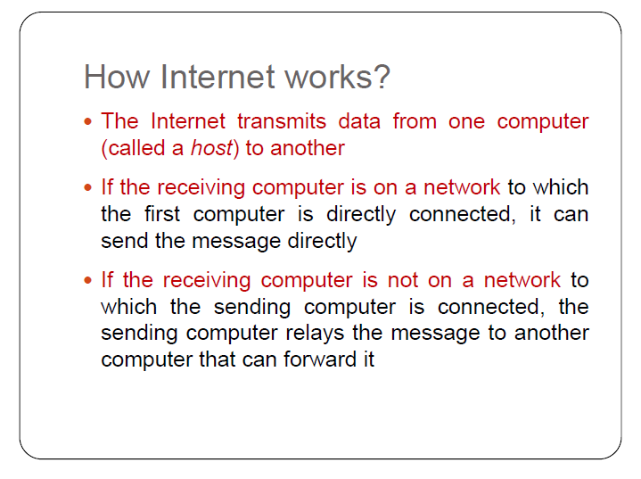
HOW INTERNET WORKS

Slide 6
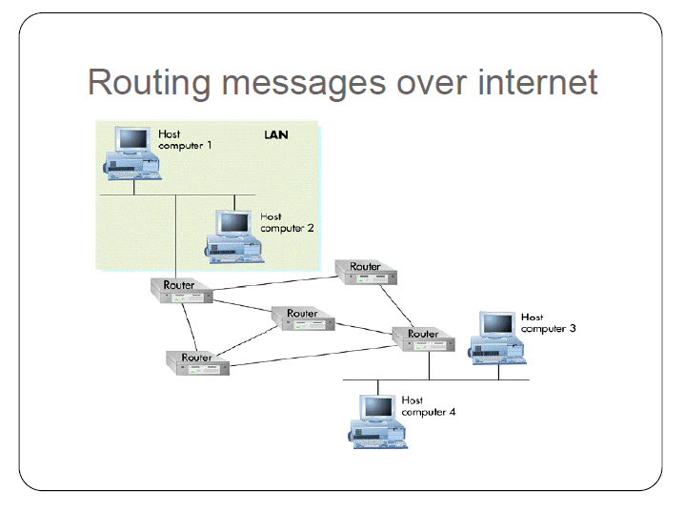
Routing messages over internet

Slide 7
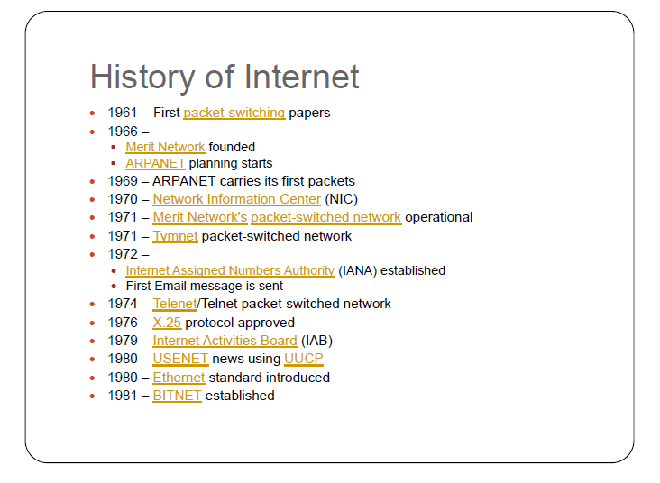
History of Internet

Slide 8
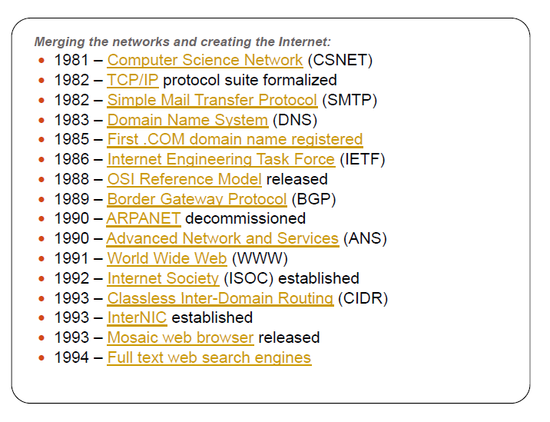
History of internet

Slide 9
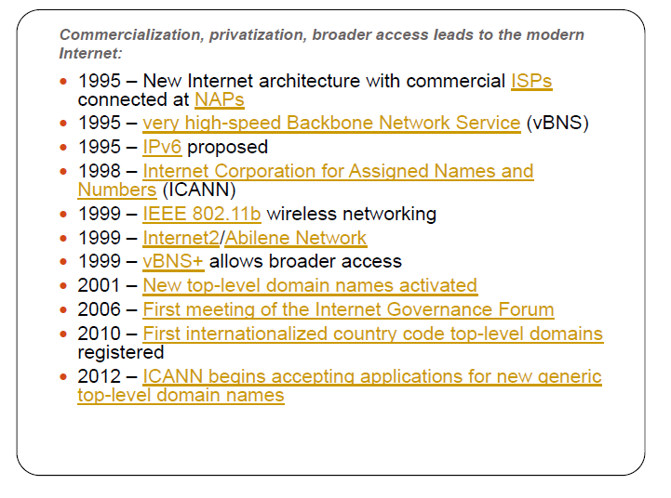
History of internet

Slide 10
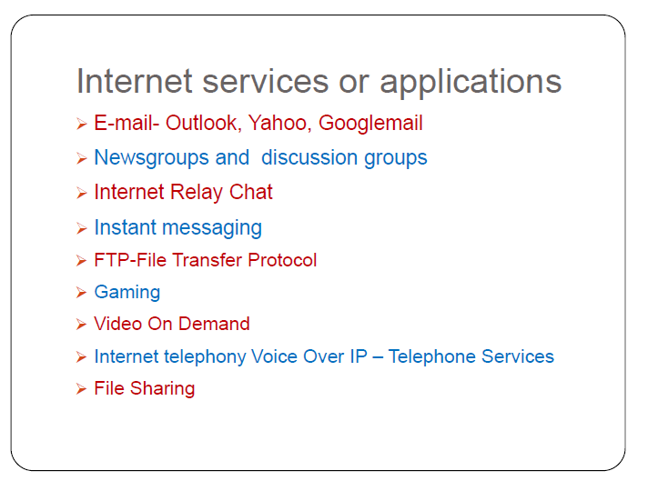
Internet services

Slide 11
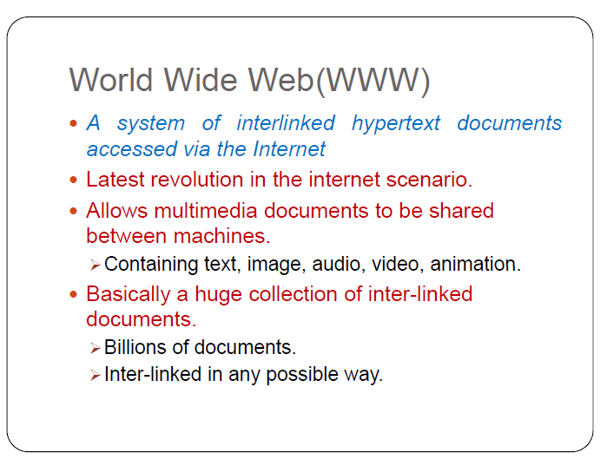
www

Slide 12
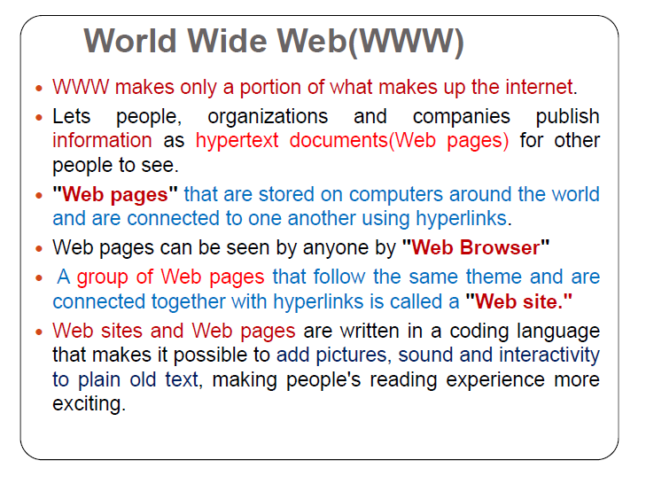
www

Slide 13
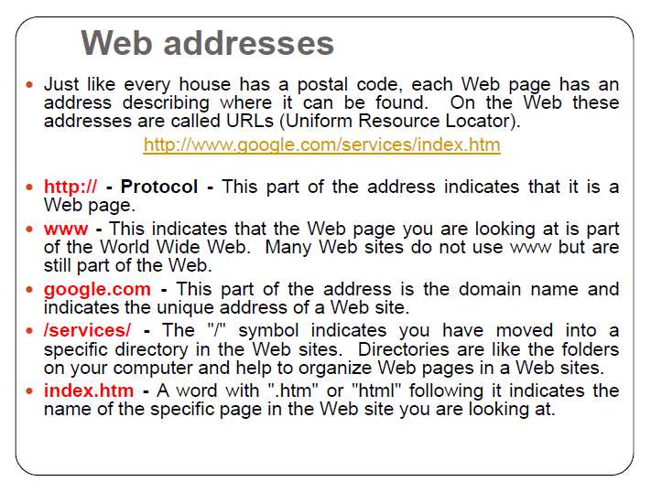

Slide 14
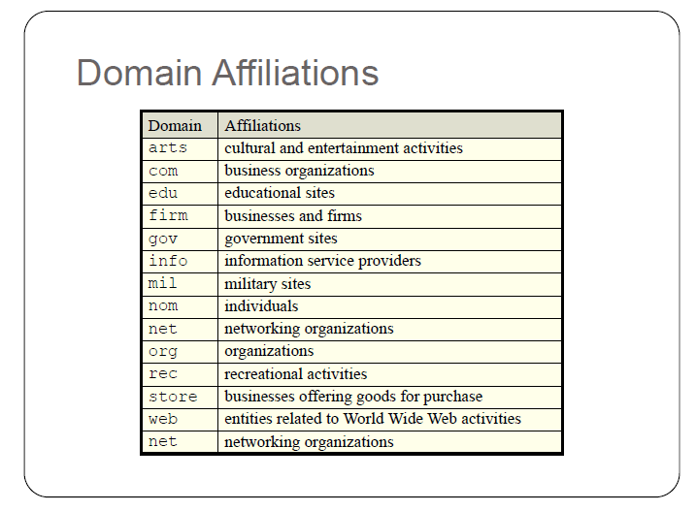

Slide 15
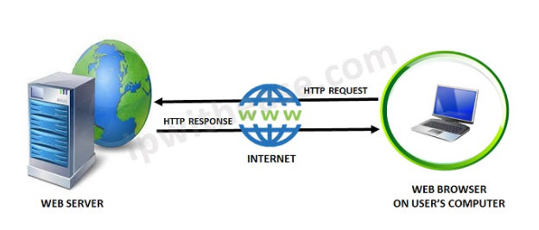
What is Web?
The Web is the common name for the World Wide Web (WWW)
The Web is just one of the ways that information is shared over the Internet.
The Web consisting of the pages that can be accessed by a Web browser such as Internet Explorer, Google Chrome, Mozilla Firefox
Web pages are formatted in a language called HTML.
The Web uses HTTP protocol to transmit data and share information.

Slide 16
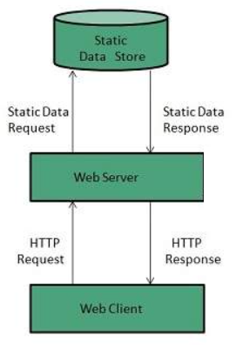
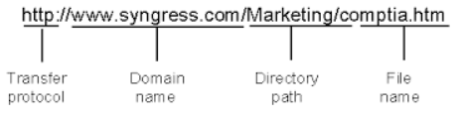
What is Web Server?
Web server is a computer where the web content is stored
Web server is used to host the web sites
When client sends request for a web page, the web server search for the requested page if requested page is found then it will send it to client with an HTTP response.

Slide 17
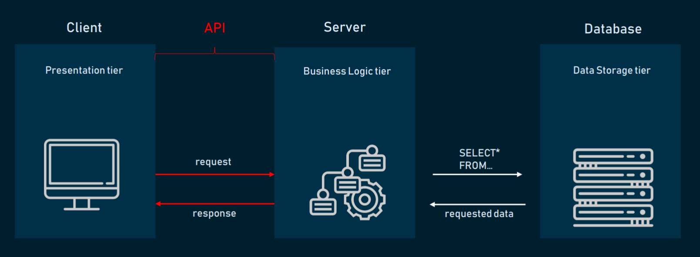
Application Architecture
HTML, CSS, JavaScript, Reactjs

Slide 18
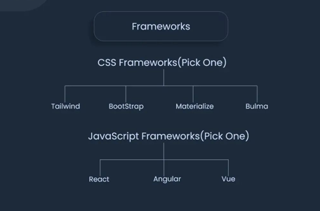
FRONTEND FRAMEWORKS

Slide 19
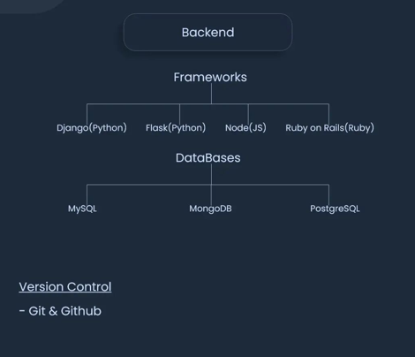
BACKEND FRAMEWORKS

Slide 20
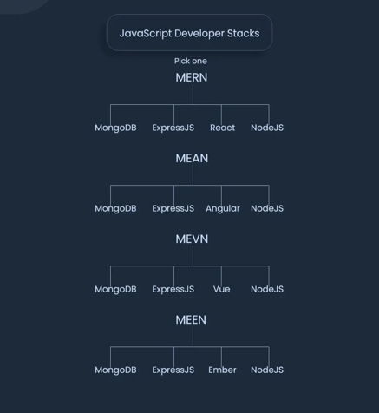
JAVASCRIPT FRAMEWORKS

Slide 21
What is HTML?
HTML (HyperText Markup Language) is the most basic building block of the Web.
HTML describes the structure of a Web page.
HTML consists of a series of elements.
HTML elements tell the browser how to display the content.
HTML elements are represented by tags.
HTML tags label pieces of content such as "heading", "paragraph", "table", and so on.
Browsers do not display the HTML tags, but use them to render the content of the page

